Slide 1
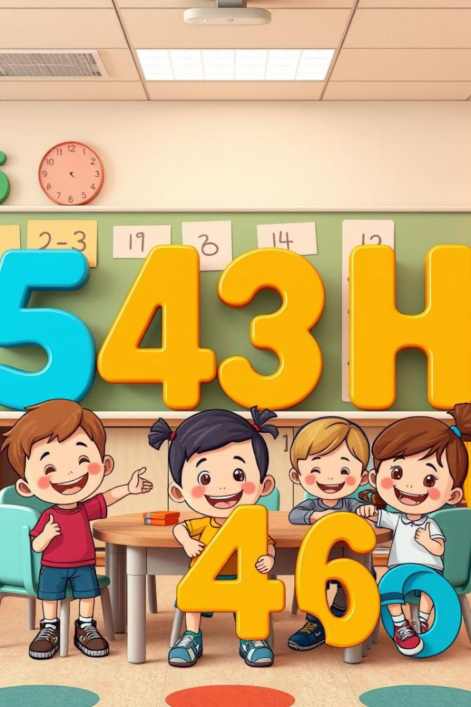

Let's Learn Addition!
Lesson 3 Putting together
by Nitya Gidnavar

Slide 2
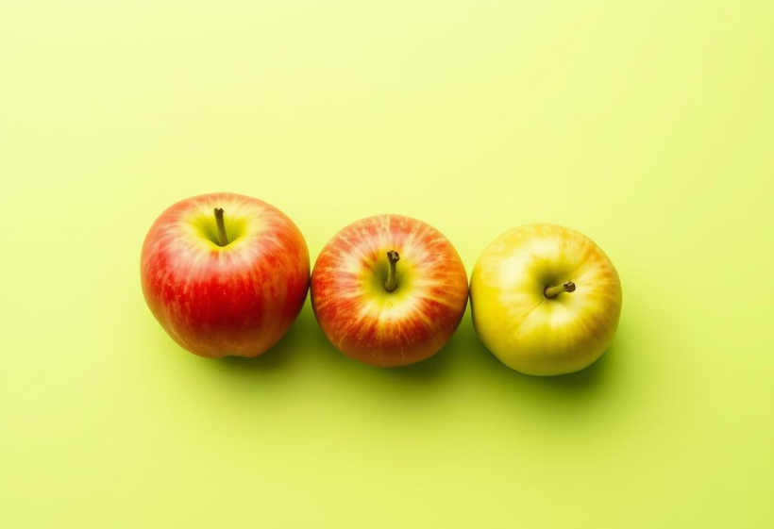
What is Addition?
Definition
Example
Addition means putting things together.
2 + 3 = ?
We use the + sign.

Slide 3
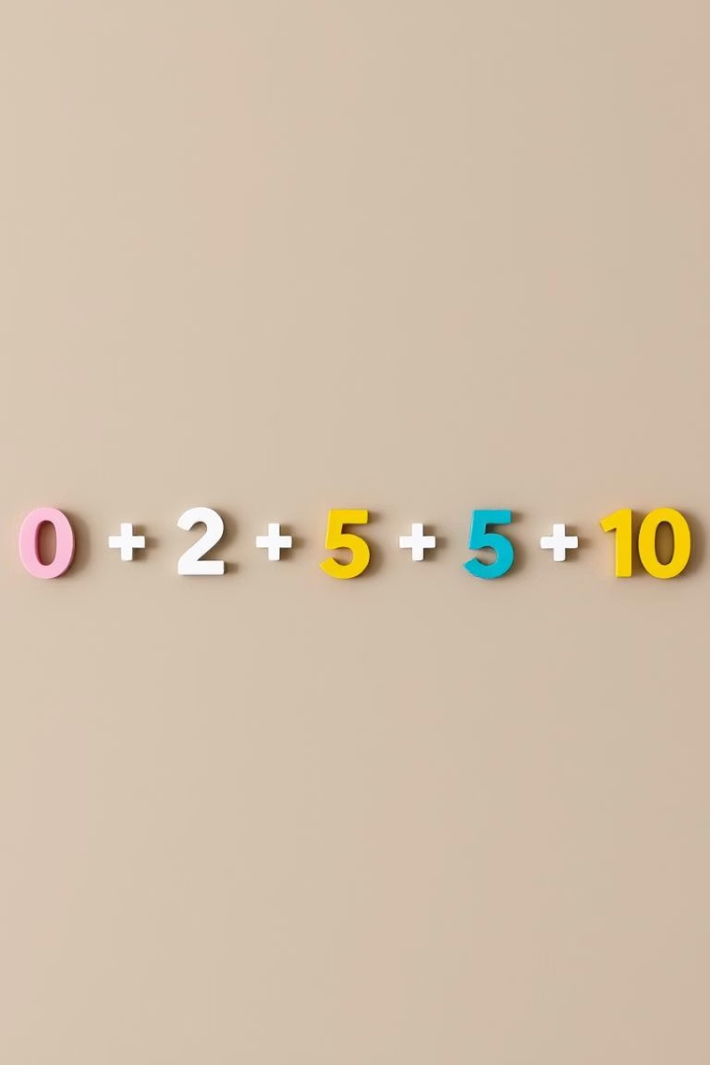
Number Line Fun
Counting Tool
Number line helps us count and add.
Example
Start at 2, jump 3 steps → land on 5.

Slide 4



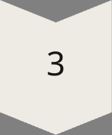
Let's Try Together!
Question 1
What is 1 + 4?
Question 2
What is 3 + 2?
Activity
Guess answers before revealing.

Slide 5

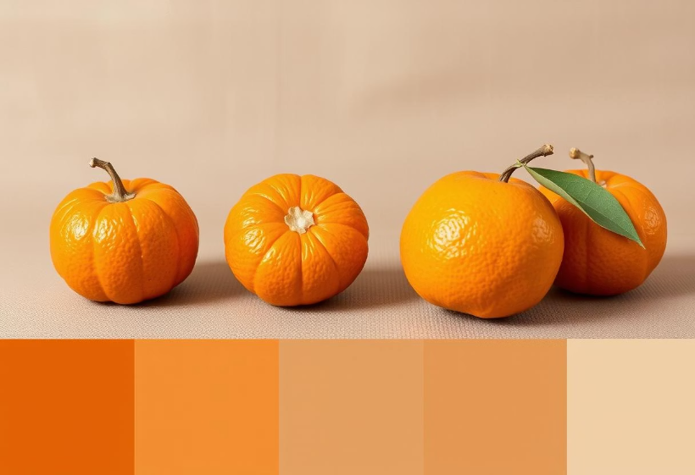
Think of Real Things
Example 1
Example 2
2 pencils + 3 more pencils = ?
4 oranges + 1 orange = ?

Slide 6

You Did It!
Great Job!
You've learned how to add!
Encouragement
You're a math star ⭐

